Slide 1


Green Pace
Security Policy Presentation
Developer: Liam Sullivan

Slide 2

OVERVIEW: DEFENSE IN DEPTH
The security policy was created to explain the more common issues and vulnerabilities found. Also to show how to fix these issues using the defense in Depth method

Slide 3
THREATS MATRIX
Likely STD-002-C STD-004-J STD-005-CPP STD-007-CPP STD-008-CPP | Priority STD-001-C STD-006-C STD-009-CPP STD-010-J
Low priority STD-002-C STD-003-C STD-004-J STD-005-CPP STD-007-CPP STD-008-CPP | Unlikely STD-001-C STD-003-C STD-006-C STD-009-CPP STD-010-J

Slide 4
10 PRINCIPLES
Validate Input data: STD-001-C, STD-002-C
Heed compiler warnings: STD-005-CPP
Architect and Design for Security Policies: STD-004-J
Keep it Simple
Default Deny
Adhere to the Principle of Least Privilege
Sanitize data Sent to Other Systems: STD-004-J
Practice defense in Depth
Use Effective Quality Assurance Techniques: STD-008-CPP, STD-009-CPP
Adopt a Secure coding Standard: STD-003-C, STD-005-CPP, STD-006-C, STD-007-CPP, STD-009-CPP, STD-010-J

Slide 5
CODING STANDARDS
The list is in order of most severe to least severe and most likely to least likely. The most severe standards should be taken care of first for best results.
1. STD-004-J: Severity is high, and Likelihood is Likely so it should be taken care of first.
2. STD-002-C: Severity is high, and likelihood is probable
3. STD-005-CPP Severity is medium, and likelihood is probable, so it takes precedent over less likely medium severities.
4. STD-003-C: Severity is medium, and likelihood is unlikely
5. STD-008-CPP: Severity is low, and likelihood is likely it takes precend over other low severities.
6. STD-007-CPP: Severity is Low, and likelihood is probable
7, 8, 9,10. STD-001-C, STD-006-C, STD-009-CPP, STD-010-J: Severity is low, and likelihood is unlikely. These two metrics are tied with each these last few, so they are grouped together

Slide 6
ENCRYPTION POLICIES
Encryption at rest refers to encrypting data that remains unused. For example, if you have a database containing usernames, passwords, or other potentially sensitive information not in continuous use, it's very important to encrypt and safeguard that data.
Encryption in flight refers to the encryption of data that is coming in or out of the system. For example, sending emails is considered encryption in transit. It means that data needs to be encrypted on its whole journey from system to system.
Encryption in use refers to the encryption of data that is currently being used by the user. This makes it so there is encryption where data is created, viewed, and edited.

Slide 7
TRIPLE-A POLICIES
Authentication refers to the process of verify the user who is trying to access the system, or certain parts of the system. There should be a username and password for each user that can be verified as to what their privileges are.
Authorization is the process of making sure and giving the right privileges to the user after they have been authenticated. An administrative user should be able to access the database so they can update it if necessary. This includes adding users if necessary.
Accounting refers to the process of logging important information for the benefit of the system. For example, a log file that records the activity of the system would be accounting. This is a big part of security as these logs can give valuable information about if the system was accessed by an unauthorized part and can shed light on how to fix this.

Slide 8
Unit Testing
The Unit tests are created to tests the properties of a collection. For example, If it is empty and if items can be added.

Slide 9
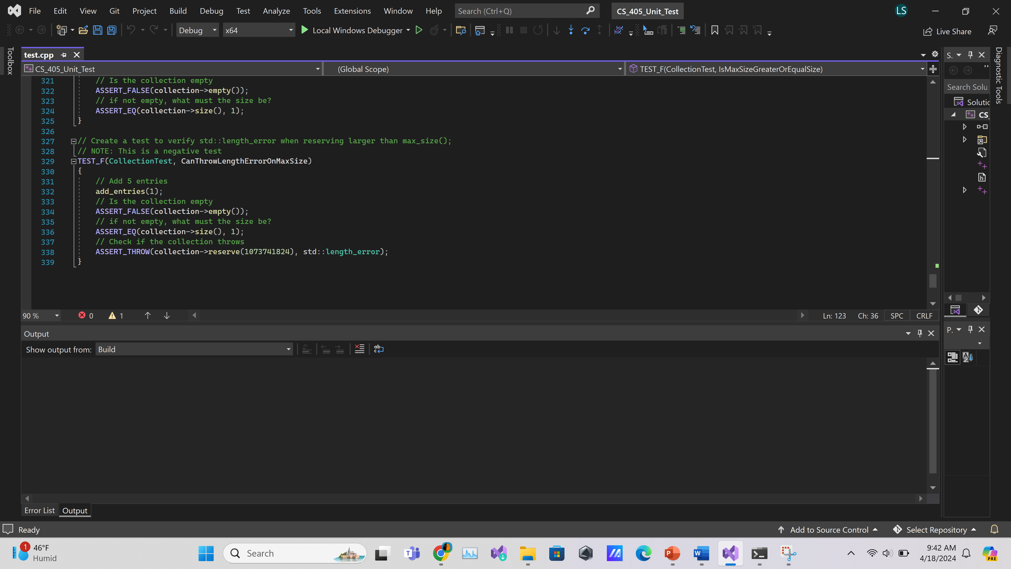
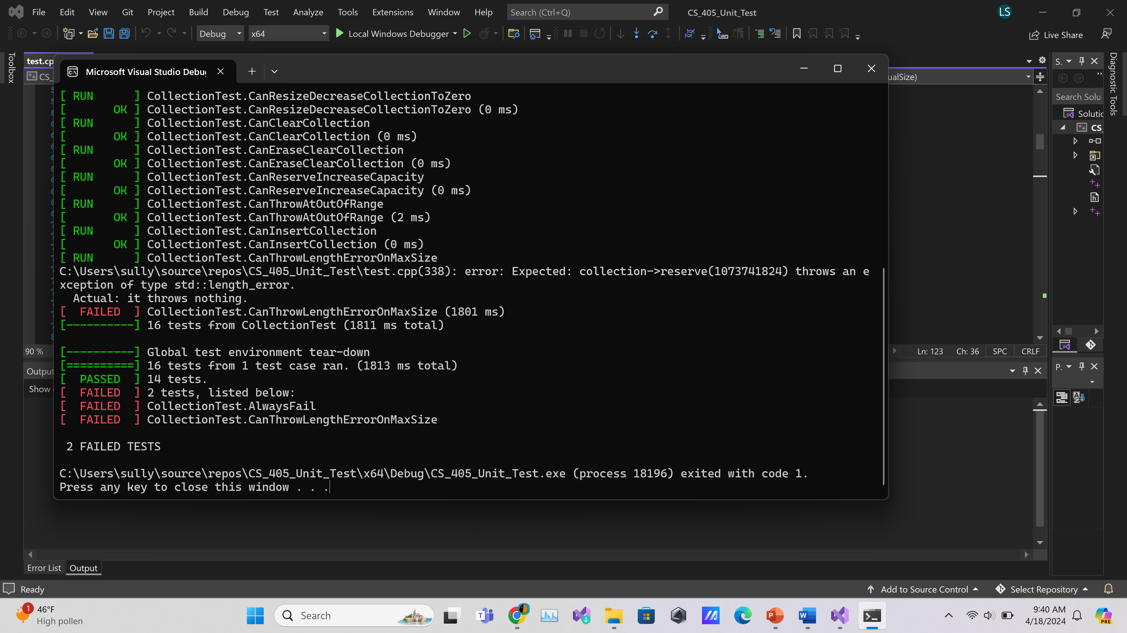
CanThrowLenghtErrorOnMaxSize
Unit test and Result

Slide 10
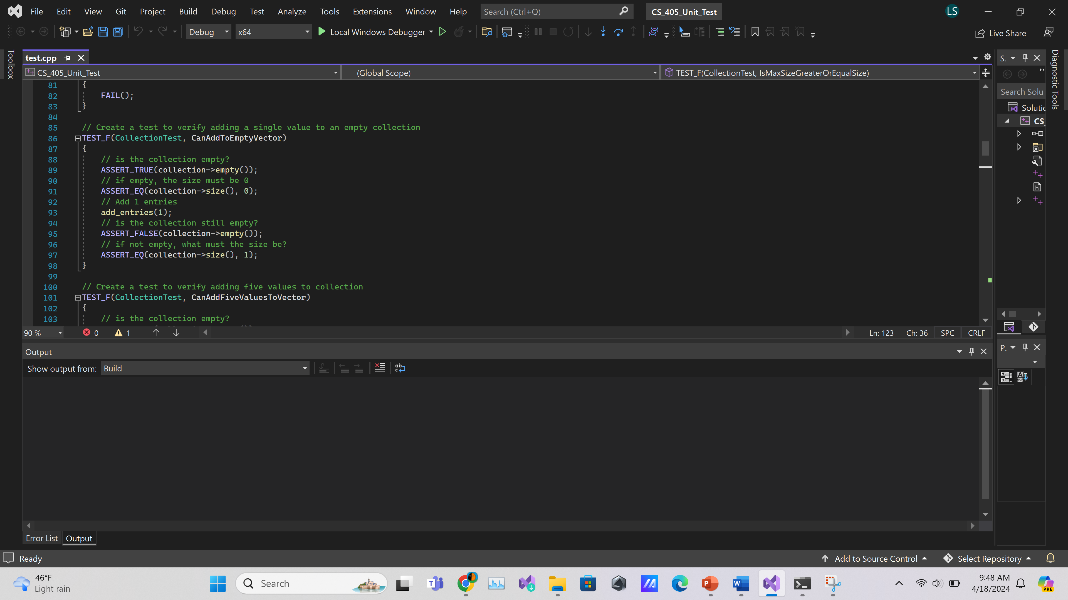
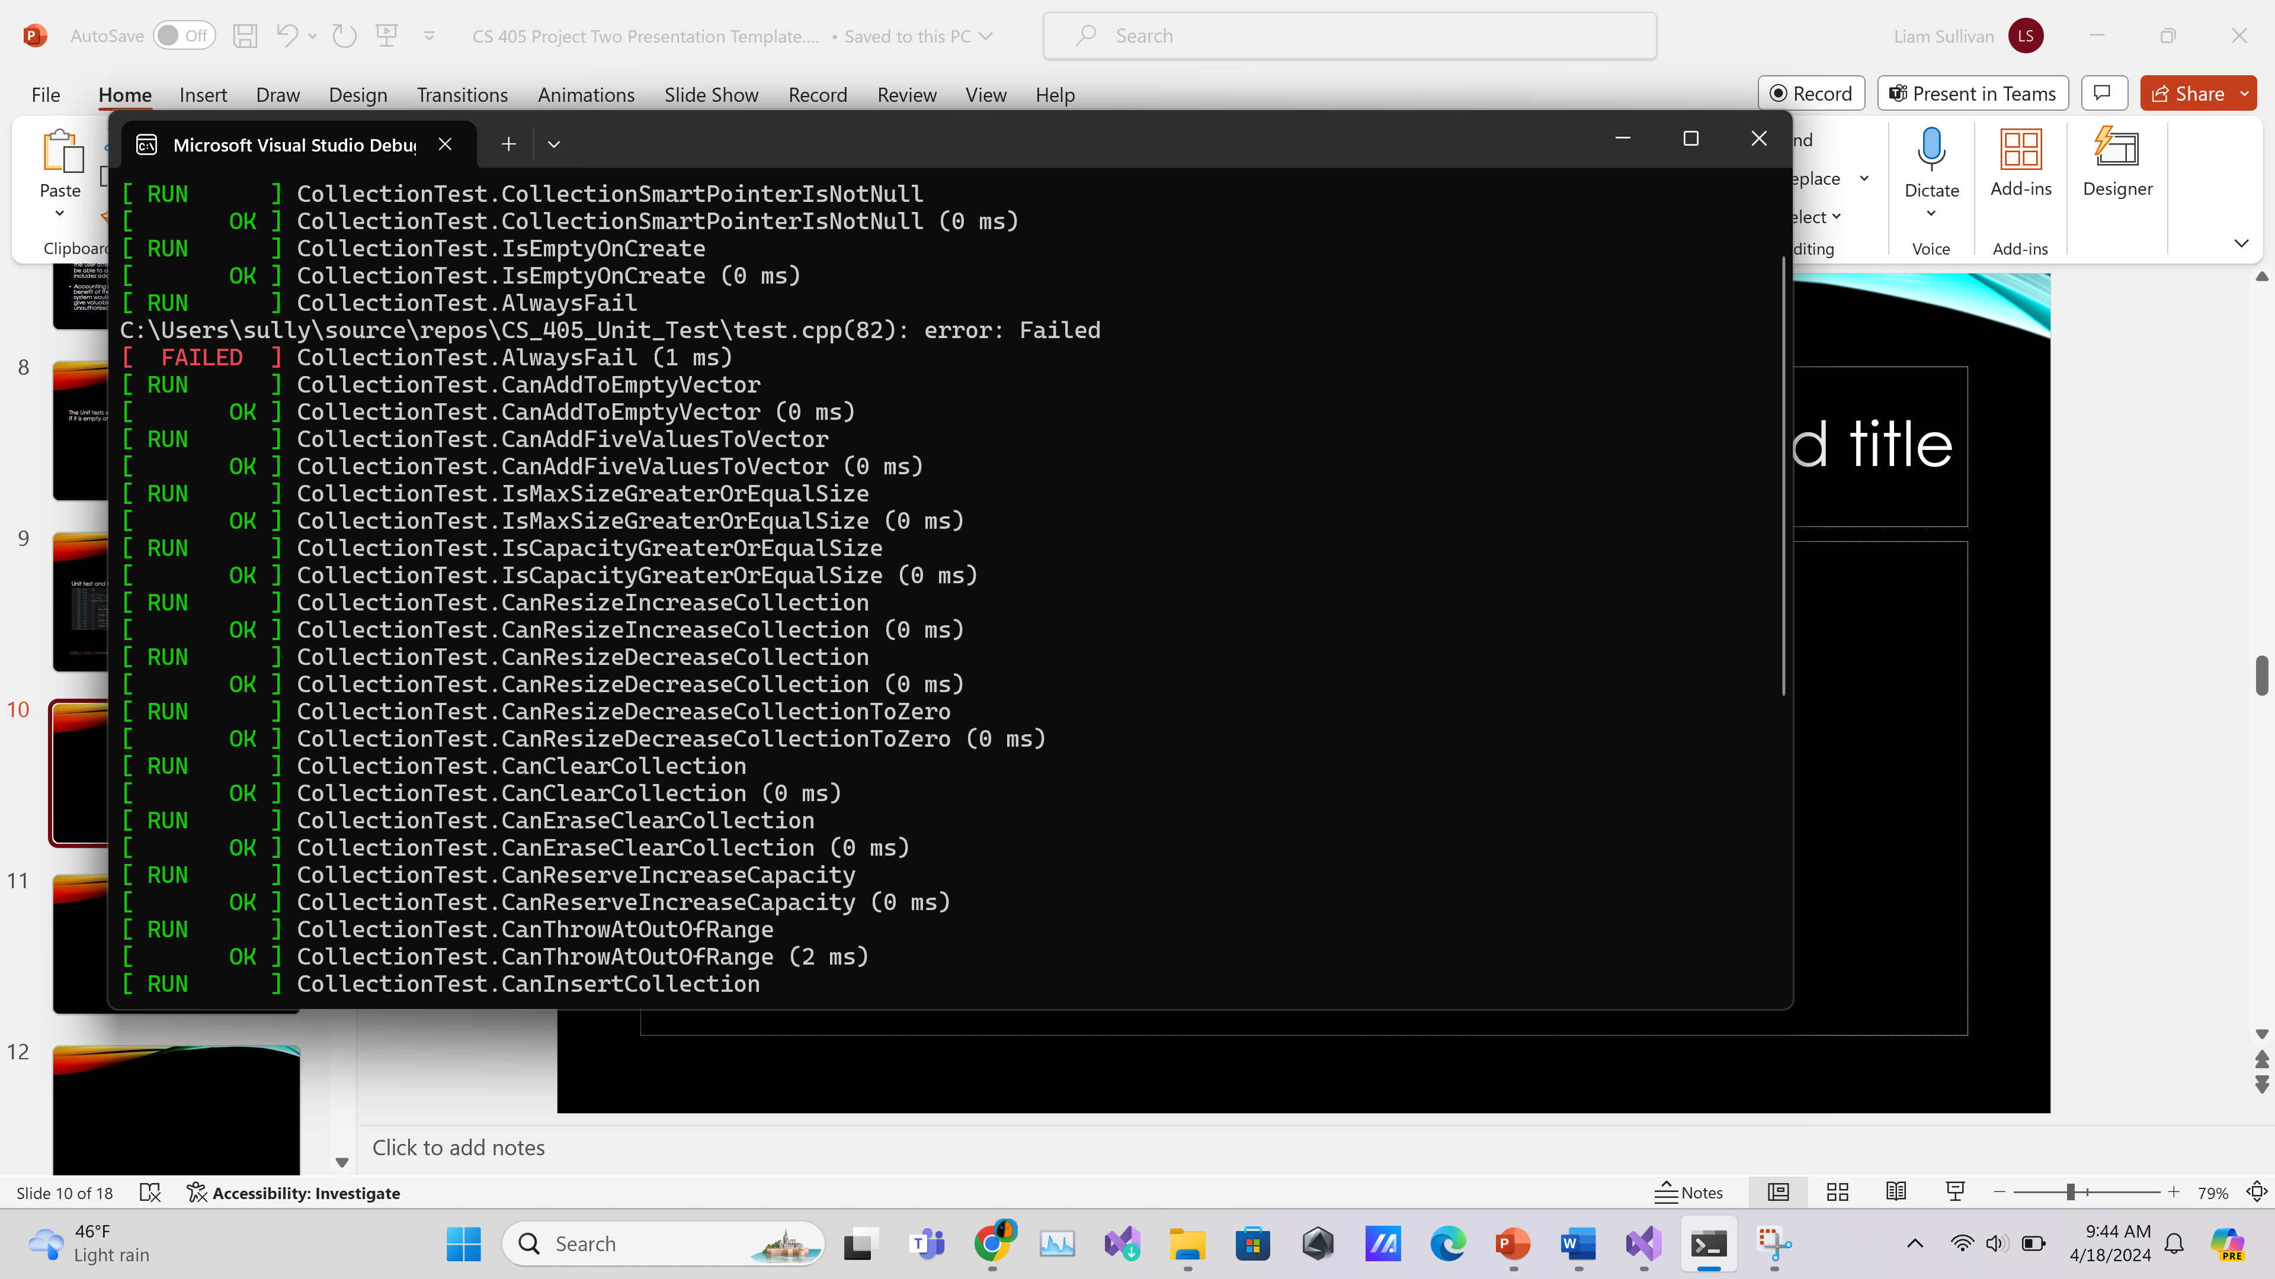
CanAddToEmptyVector
Unit Test and Result

Slide 11
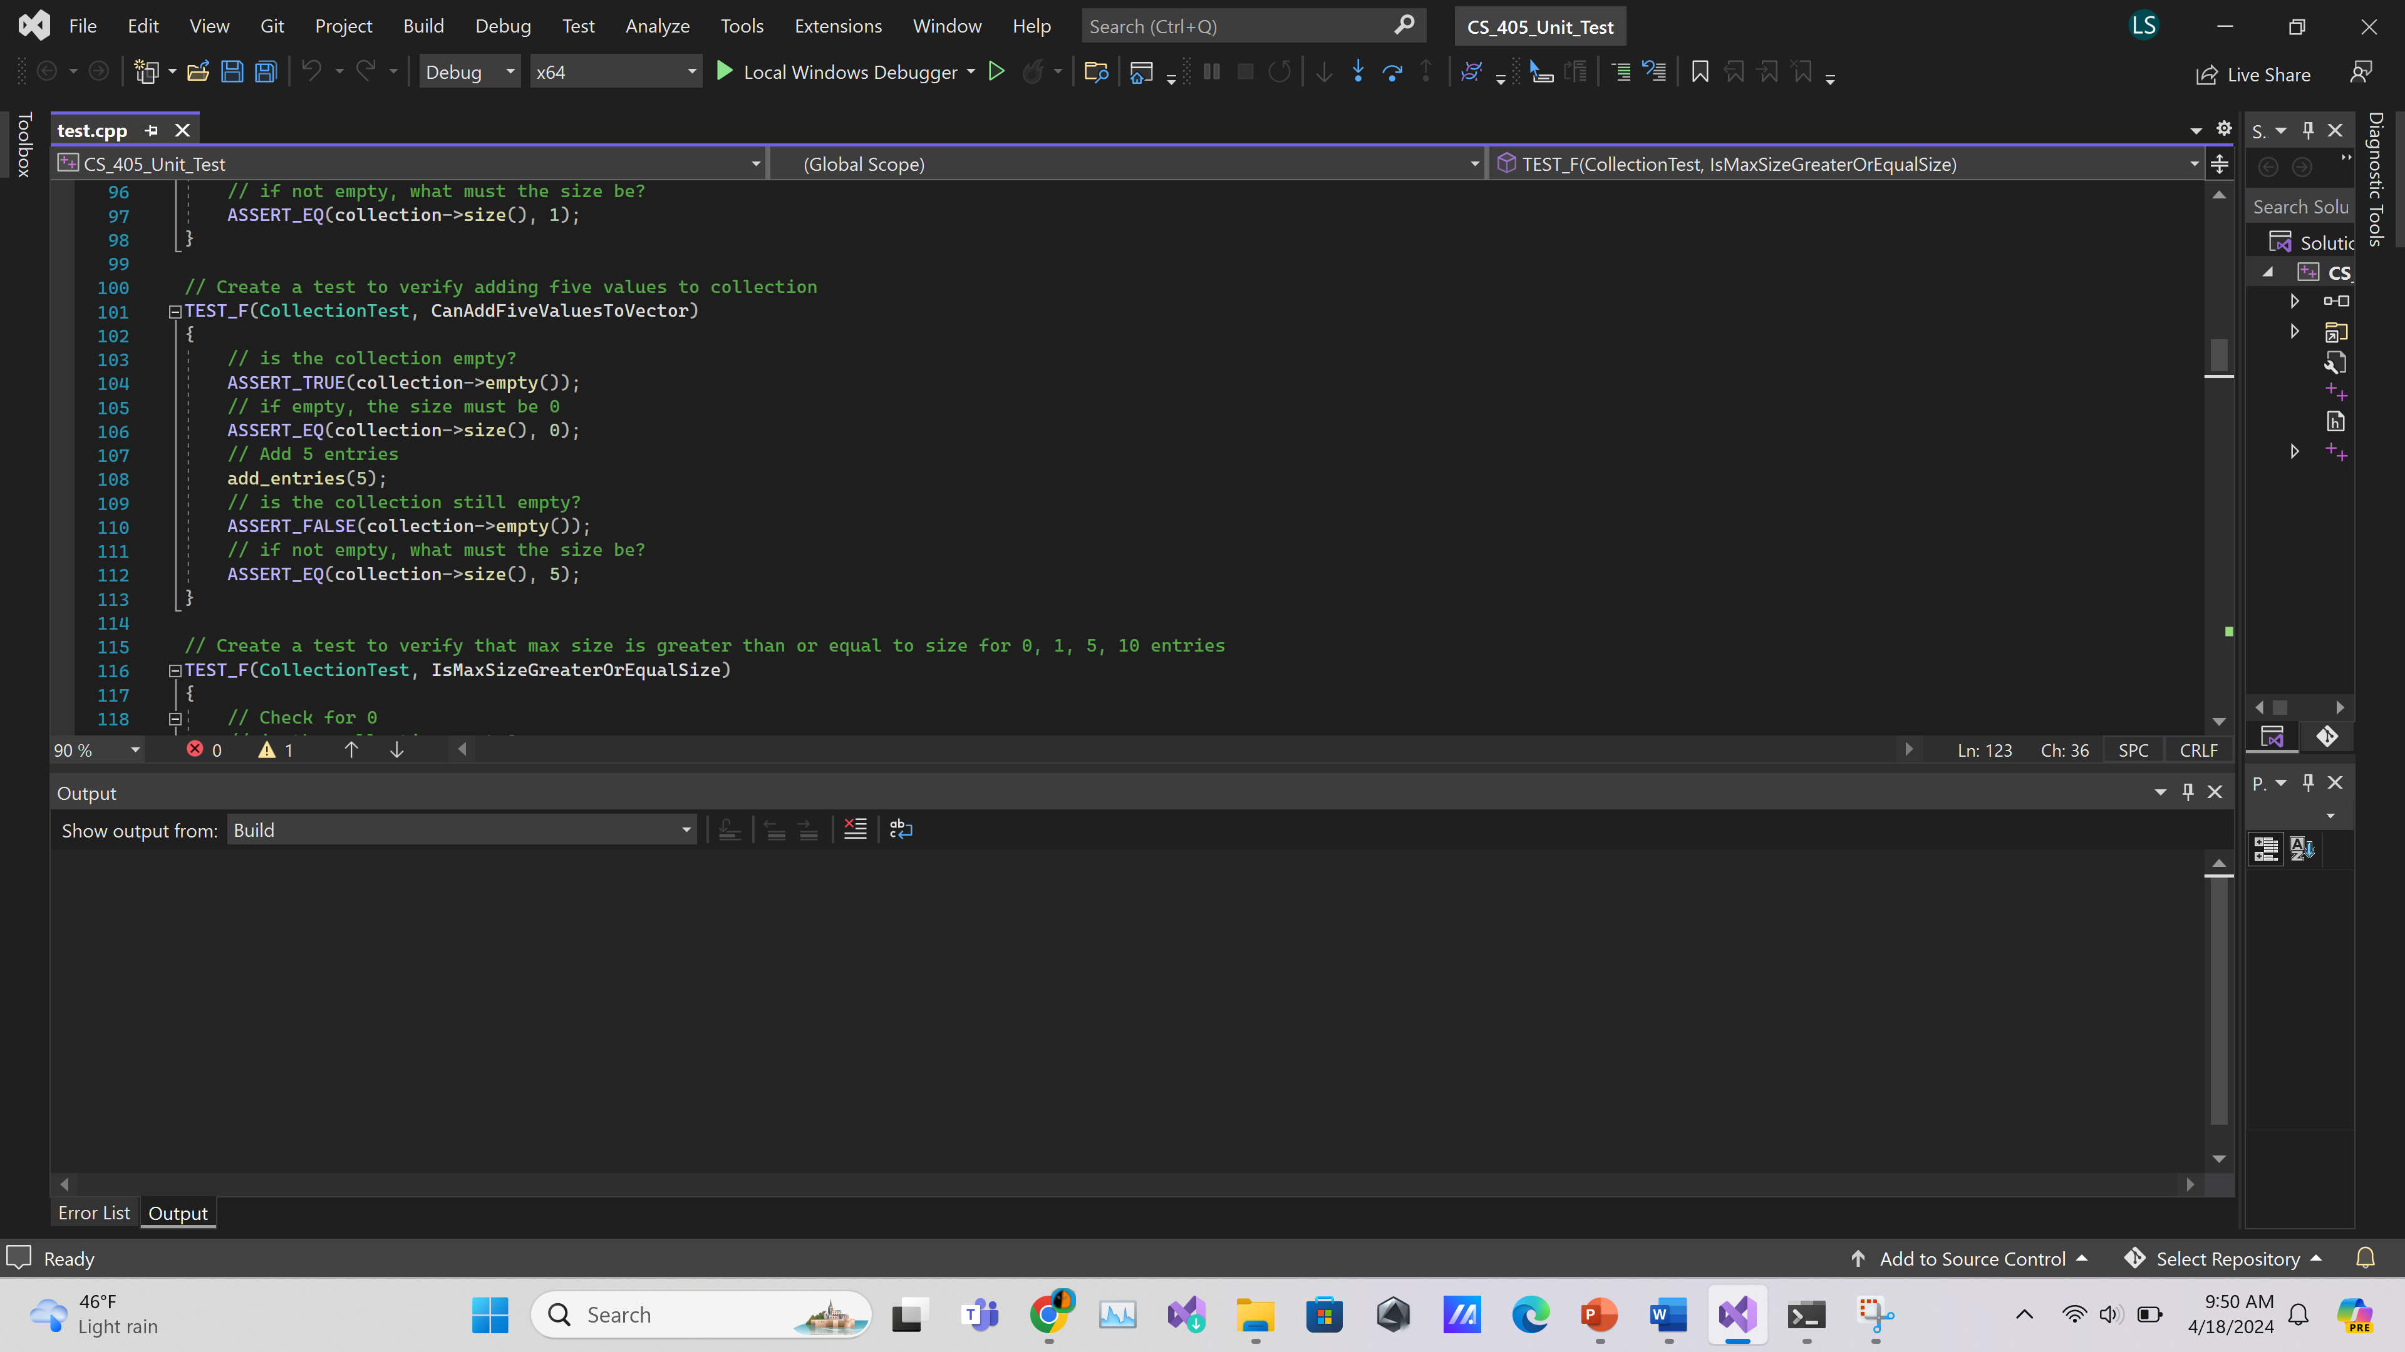
CanAddFiveValuesToVector
Unit Test and Result

Slide 12
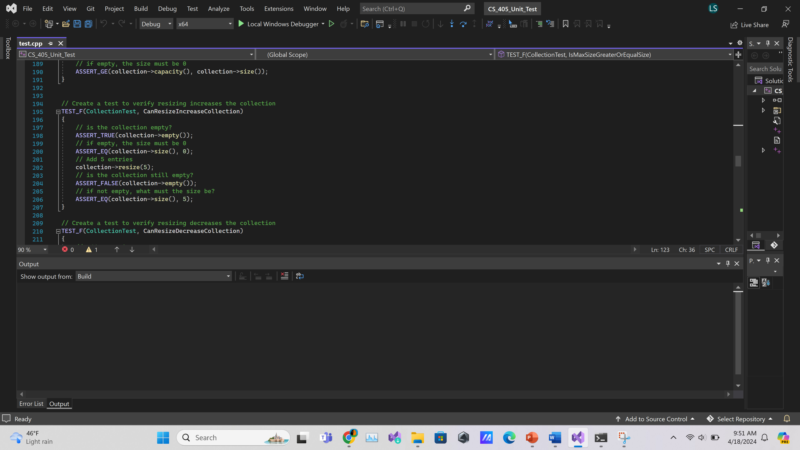
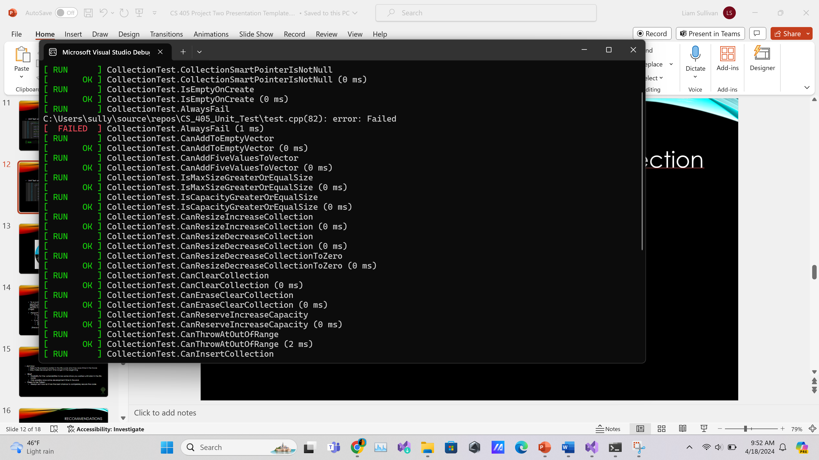
CanResizeIncreaseCollection
Unit Test and Result

Slide 13

AUTOMATION SUMMARY

Slide 14
TOOLS
“In a nutshell, DevSecOps pipelines are automated workflows that incorporate security practices throughout the development lifecycle. These pipelines integrate security controls, testing, and monitoring at every stage, ensuring that security is not an afterthought but an inherent part of the development process.”
(Yuga)
Parasoft is a tool that can be used to help in the DevSecOps pipeline
It can help in the “Verify and Test” phase as it comes with many helpful tools
Static Code Analysis
Unit Testing
Functional Safety Compliance
It can help with the “Monitor and Detect” phase
Structural Code Coverage
Requirements Traceability
Report and Analytics
(Parasoft)

Slide 15
RISKS AND BENEFITS
Act Now:
Helps to fix problems earlier in the life cycle and may save time in the future
May make development time longer in the beginning
Wait
Possibility for the vulnerabilities to be worse since you waited until later in the life cycle
Can possibly save some development time in the end
Steps to be Taken:
Always act now as it has the best chance to completely secure the code

Slide 16
RECOMMENDATIONS
Periodically check the permissions and make sure everything is as it should be
Periodically conduct unit tests to make sure everything is running as it should be
Use Parasoft for better management and autmotion

Slide 17
CONCLUSIONS
To prevent future problems:
Utilize the standards that have been outlined
Make sure there are good unit tests in place
Conduct periodic audits of the project (Permissions, Logs)
Doing these things will help make sure that the project is secure now and in the future.

Slide 18
REFERENCES
Yuga. (2024, April 7). What is DevSecOps pipelines? - Comprehensive guide - Practical DevSecOps. Practical DevSecOps. https://www.practical-devsecops.com/what-is-devsecops-pipelines
Parasoft. (2024, April 4). Parasoft. https://www.parasoft.com/

